Slide 1

Mojtaba Ghasemi
Single-cell RNA Sequencing Analysis: Unveiling Cellular Differentiation and Maturation

Slide 2
Introduction to scRNS-seq
Single-cell RNA sequencing (scRNA-seq) represents a transformative advancement in genomics, offering an unparalleled view into individual cell dynamics.
This method reveals cellular heterogeneity, identifies rare cell types, and elucidates developmental pathways in unprecedented detail.
Image suggestion: An illustration of the scRNA-seq workflow or a graphic showing cellular differentiation at a single-cell level.
Notes:
za

Slide 3
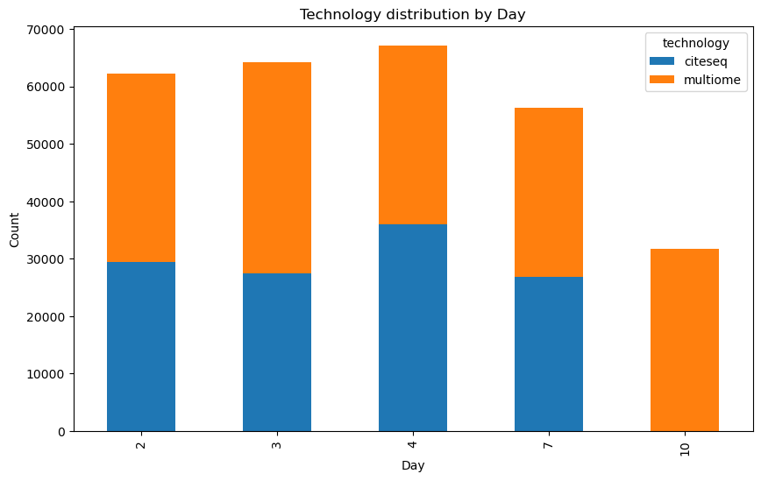
Problem Statement and Objectives
Problem Statement: "The challenge in scRNA-seq analysis lies in correlating the complex interactions among DNA accessibility, RNA expression, and protein synthesis during cellular development.
Objectives:
Characterize gene expression profiles throughout cell differentiation.
Develop predictive models for cellular differentiation trajectories.
Identify biomarkers for cell maturation and differentiation.

Slide 4
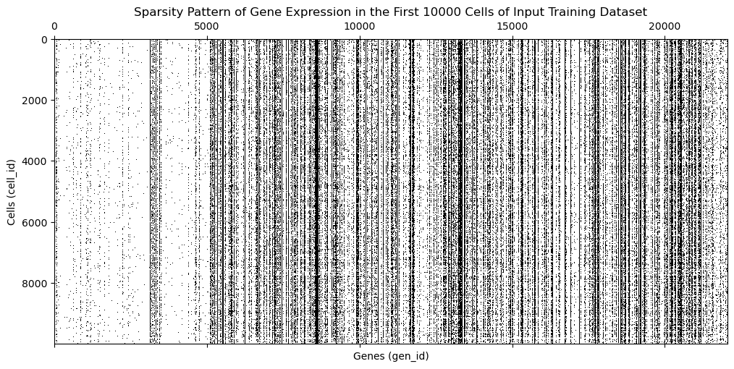
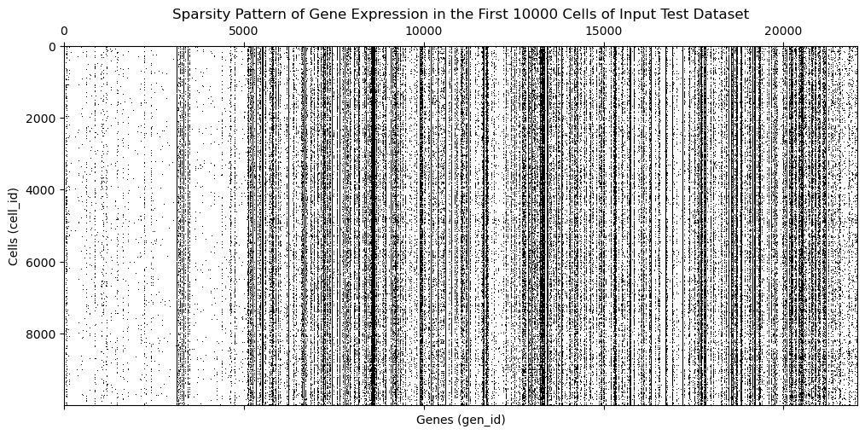
Data Wrangling Overview
Data was sourced from comprehensive scRNA-seq datasets, focusing on the transition of bone marrow stem cells into mature blood cells.
Data cleaning and preprocessing involved handling missing values, correcting batch effects, and normalizing gene expression levels.
Feature selection aimed to identify relevant genes and proteins, employing variance filtering and correlation analysis.

Slide 5
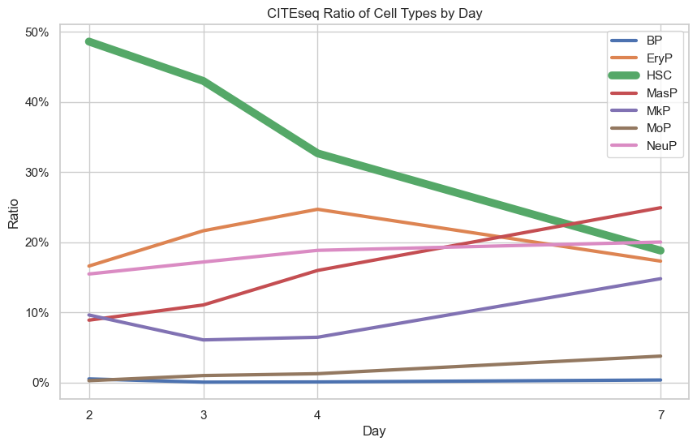
Exploratory Data Analysis (EDA)
The EDA aimed to uncover underlying patterns, identify anomalies, and generate hypotheses about the cellular differentiation process.
Univariate analysis summarized individual variables, focusing on gene and protein expression levels.
Bivariate and multivariate analyses explored relationships between genes and proteins, highlighting potential biomarkers and signaling pathways.

Slide 6
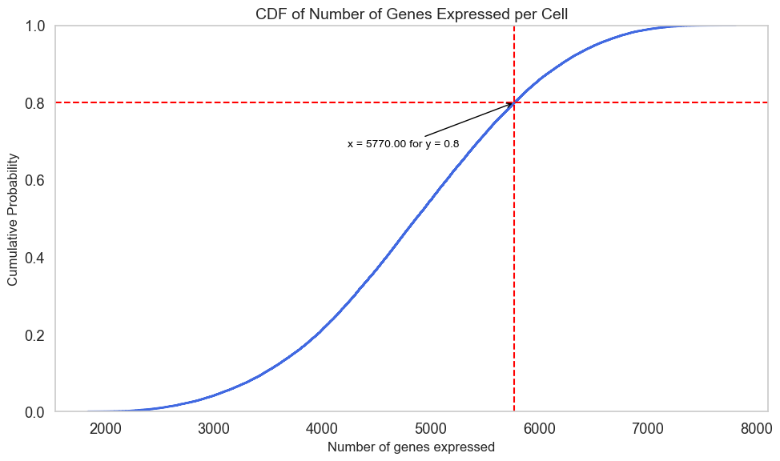
Modeling Approach
Chose LightGBM for its efficiency and effectiveness, particularly with large-scale data like the CITEseq dataset.
Implemented dimensionality reduction to manage high-dimensional data, using techniques like truncated SVD.
Trained 140 LightGBM models, one for each target variable, ensuring robustness through cross-validation.

Slide 7
Model Evaluation and Results
Employed Pearson correlation and mean squared error (MSE) as key evaluation metrics to assess model performance.
Structured cross-validation framework ensured the model's generalizability and predictive accuracy.
Key findings highlighted significant gene-protein relationships crucial for understanding cellular maturation.

Slide 8
Conclusions and Implications
The study revealed intricate relationships between gene expressions and protein levels, enhancing our understanding of cellular differentiation.
Findings offer a foundation for therapeutic strategies targeting specific cellular pathways in disease treatment.
Implications extend to regenerative medicine, disease diagnosis, and the development of personalized medical approaches."

Slide 9
Recommendations and Future Directions
Future research should explore the identified biomarkers and their roles in cellular processes.
Practical applications might include the development of diagnostic tools or therapeutic strategies targeting cell differentiation stages.
Encourages an interdisciplinary approach in genomics research, integrating computational and biological sciences.

